Slide 1


Rolls-Royce SMR
Clean, Affordable, Energy For All
Exporter’s Forum, Czech Republic, April 2025
Ed Coxon – Senior Business Development Manager

Slide 2
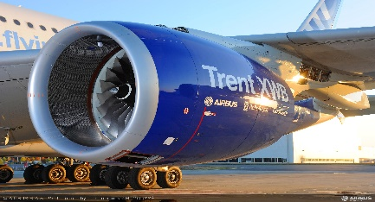
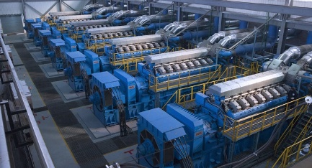

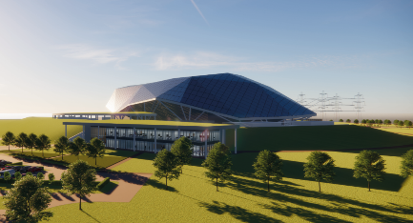
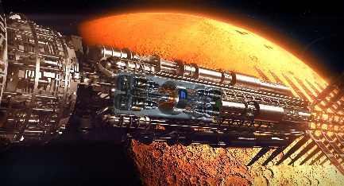
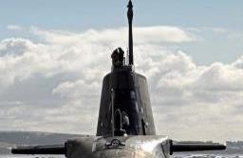
    Rolls-Royce is one of the world’s leading industrial technology companies pioneering cutting-edge technologies that deliver clean, safe and competitive solutions
Rolls-Royce’s
Nuclear Heritage
Civil Aerospace
Power Systems
Defence
Strong nuclear heritage with roots in defence and civil development
Designing, manufacturing and supporting small reactors for over 60 years
Rolls-Royce is a globally recognised and trusted partner
    Strong nuclear heritage with roots in defence and civil development
Nuclear Business Experience
Civil Nuclear
Defence Nuclear
Rolls-Royce SMR
Innovation & Future Programs
Submarines
Notes:
Ed Coxon
Not Sensitive

Slide 3
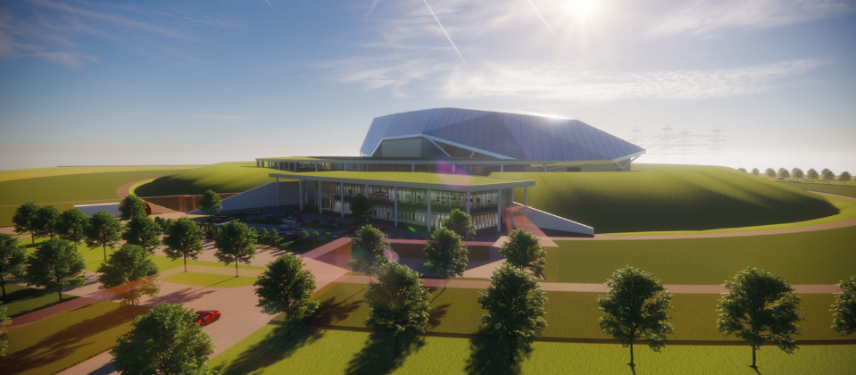






Rolls-Royce SMR Ltd is a technology vendor offering a complete SMR power plant
Our development programme is funded through a mixture of commercial equity and UK Government grant funding with shareholders bringing strategic value to the programme
Rolls-Royce SMR Ltd Shareholders
Constellation Energy (previously Exelon Generation Ltd)
Operates the largest U.S. fleet of zero-carbon nuclear plants with over 18.7GW from 21 reactors at 12 facilities
BNF Resources UK Ltd
Extensive investments in the energy space and represented and advised by BNF Capital Limited, an FCA regulated UK-based investment advisory
Rolls-Royce Group
60 years designing, manufacturing, supporting and operating nuclear technology
Qatar Investment Authority
Invests in the energy transition and funds technologies that enable low carbon electricity generation
CEZ Group
Czech state utility operating a over 12GW of energy assets with 6
operational reactors in Europe
UK Government Grant Funding
UK Department of Energy Security and Net Zero
Rolls-Royce SMR Ltd received the Low-cost nuclear (LCN) grant award by UK Research and Investment (UKRI)
Notes:
Jordan
Not Sensitive

Slide 4
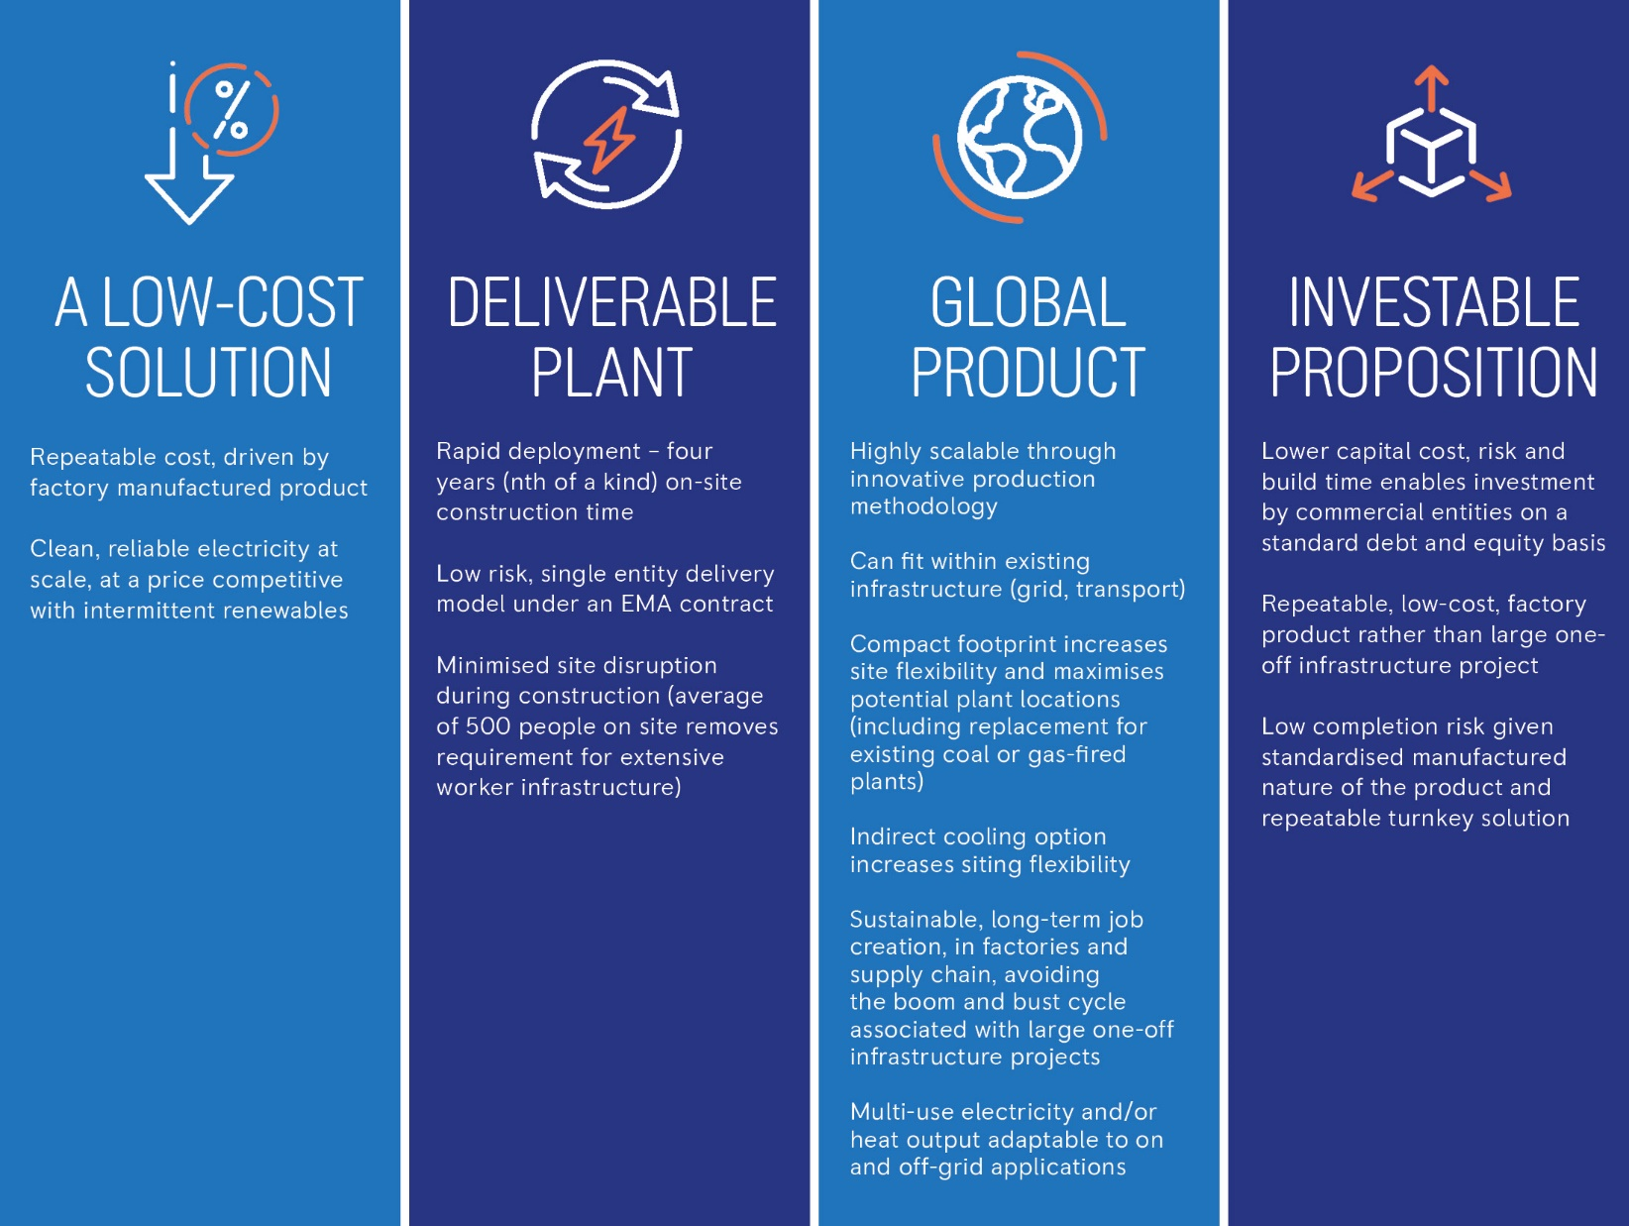
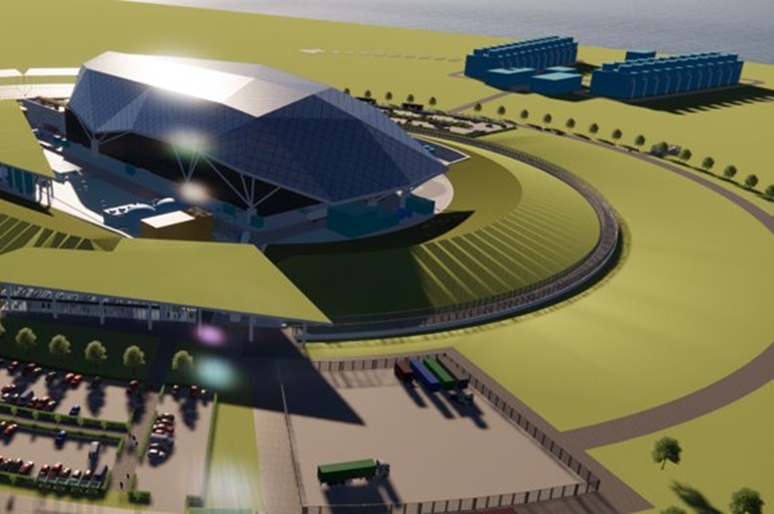
What the
Rolls-Royce SMR approach delivers

Slide 5
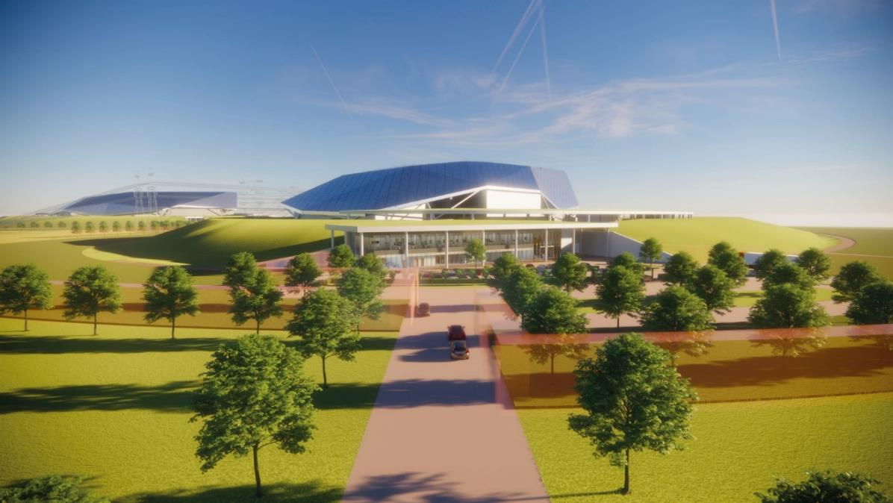
Power Station Overview - Performance and Characterisation
The key performance parameters and characteristics that define the power station.
MAJOR TECHNICAL PARAMETERS:
Parameter | Value
Reactor Type | Pressurised Water Reactor
Electrical Capacity (MWe) | 470
Thermal Capacity (MWth) | 1358
Expected Availability (%) | Up to 95
Design Life (years) | 60
Primary Plant Footprint (m²) | 147,800
Power Conversion Process | Rankine cycle
Cogeneration Capability | Possible configuration
Passive Safety Features | Yes
Active Safety Features | Yes
Fuel Type / Assembly Array | Industry Std UO₂ in 17x17 array
Fuel Cycle (months) | 18 – 24
An integrated whole power station approach focused on standardisation, repeatability and commoditisation
Notes:
Jordan
Not Sensitive

Slide 6
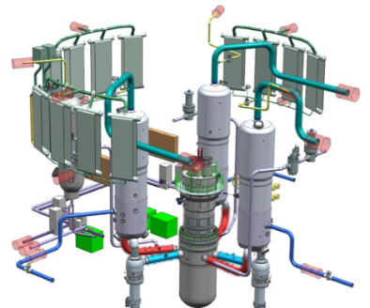
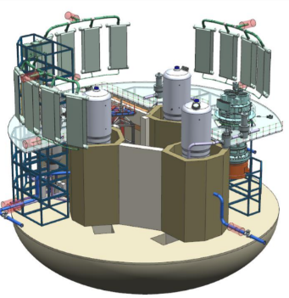
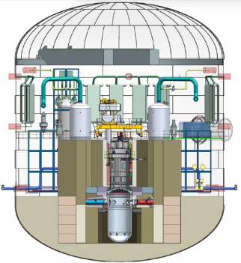
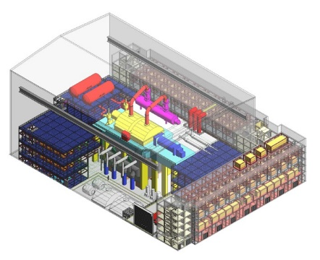
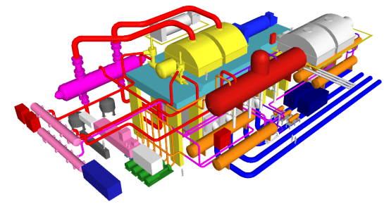
Our fundamental technology is proven and low risk with innovation where it adds value
REACTOR SYSTEMS
COOLING WATER ISLAND
TURBINE ISLAND
A robust and licensable design:
  3-loop compact PWR
  Based on proven technology
  Compliant with all UK codes & standards
Fuel: industry standard 17x17 assembly UO2
Boron-free design to reduce environmental impact.
3 Local Ultimate Heat Sinks provide passive heat removal and long-term cooling in faulted condition
Phased long-term emergency core cooling solution provides ultimate CAT A safety measure
Indirect cooling GDA baseline for maximum site flexibility
Adaptable to site conditions and requirements
Modular Mechanical draught cooling towers
Direct cooling configuration also developed – both possible
Conventional turbine technology implementing modular strategy

Slide 7
Low cost
Deliverable
Investable
Global and scalable
The SMR design has been driven by market requirements from conception
Those that we can control within the design
Those that we must recognise as key influencing factors on design and technology choices
Regulatory / Safety
Proliferation Resistant
Market Timing
Code Compliance
Reduce
Capex & Opex
Remove /
Reduce Risk
Minimise
Time to Build
LCOE
Levelized Cost of Electricity
(USD/MWh)
Capex + total O&M + Decom + Fuel + Financing
=
Power Generation x Capacity factor
Maximise
Power
Maximise
Reliability
Maximise Efficiency
Compatibility with support Infrastructure and Sites
Public Perception
Utility Familiarisation / Selection of Technology
Delivery Partnership Potential
Global Market
Notes:
Laura (or replace with the below slide?)
Not Sensitive

Slide 8
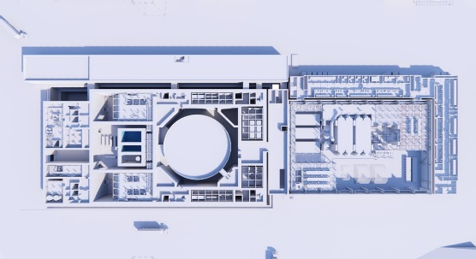
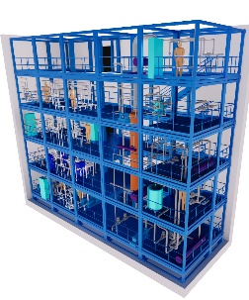
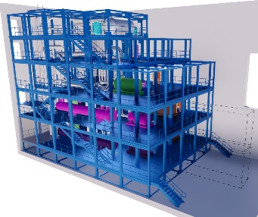
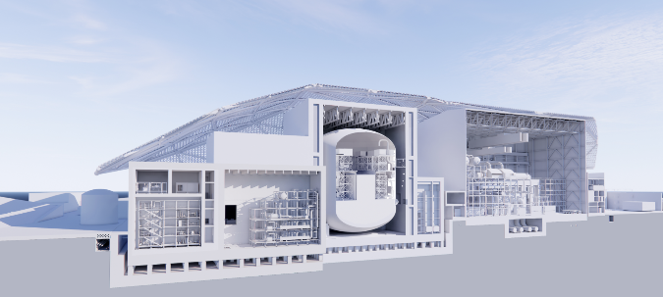
SMR is about doing nuclear differently, not replicating large plants on a smaller scale
Small
Is about maximising the power against the physical constraints applied to the design – optimising economics
Small footprint and reduced site activity
Modular
Standardisation, factory repeatability in a production line approach.
Avoidance of large modules that must be disassembled for transportation - defeats the benefits of modularisation
Move volume of activity off site and into factories
Reactor Power Plant
Reactor is only ~20-30% of the power plant by capital value
Must look at modularisation and standardisation of the whole power plant including civil construction
Otherwise we are not addressing the challenges of Repeatability, Buildability and Deliverability
(Capex + Opex +
Decom + Fuel + Financing) .
LCOE =
Power Generation
x Capacity Factor

Slide 9
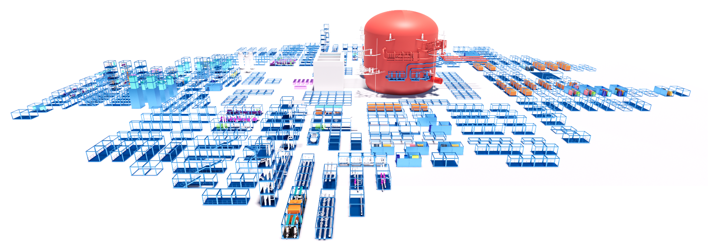
Standardised kit of parts that underpin a whole powerplant solution developed in a fully digital environment from the outset
The RR SMR “kit of parts”
The digital design of the Rolls-Royce SMR has enabled the continuous refinement of our modular solution to the latest configuration of functional system modules and enables us to control and manage all aspects of the plant’s development
Our design covers the entire powerplant solution, not just the reactor island, which maximises standardisation across sites but also positions us well for the development of our aftermarket support and services opportunities
Notes:
11

Slide 10
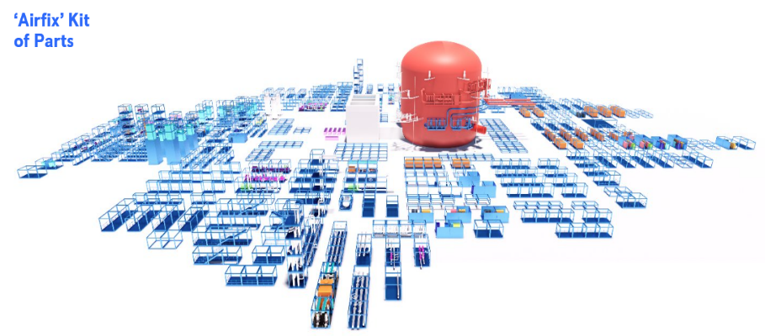
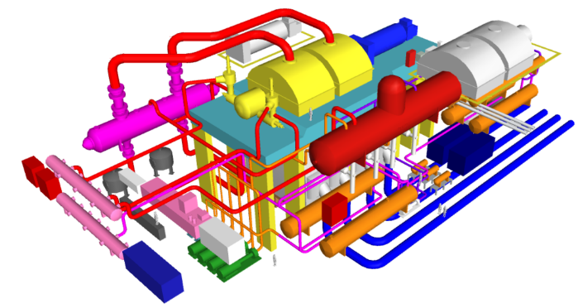




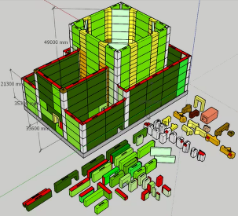
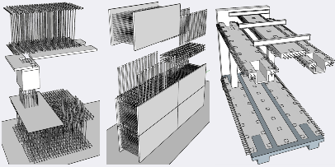
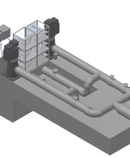
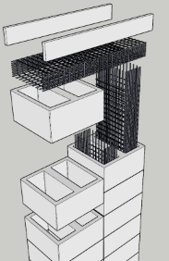
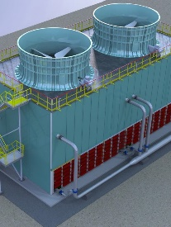
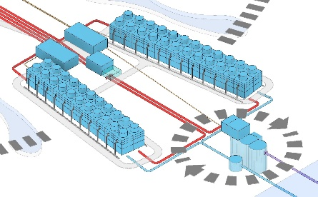
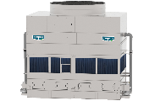
We have a standard ‘kit of parts’, common to all projects which are assembled and tested at module level in controlled factory environments prior to site delivery
..to reduce cost, bring cost and schedule certainty, and remove or reduce risk
Reactor Island
Turbine Island
Integrated Design, Procurement, Quality & Procedures
Civils Modules:
Cooling Water Island

Slide 11
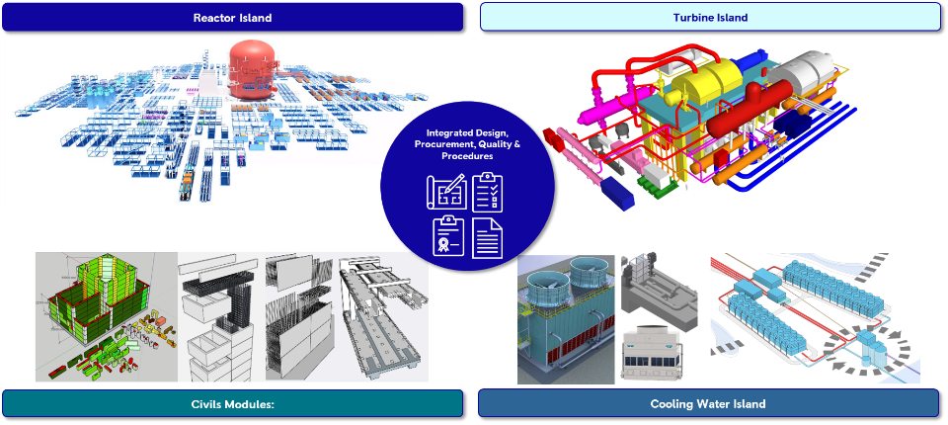
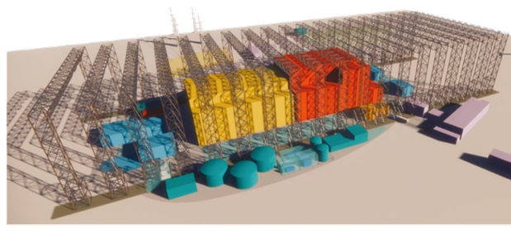
Our site activity is dramatically reduced and conducted in a temporary factory environment
…to remove environmental risk, bring schedule certainty and therefore improve investability
Standard Product (>70% of total project value)
Standard. repeatable, factory fabricated product
It is common across all power plants
Factory products bring cost and schedule certainty
Commoditised where possible and avoidance of supply chain bottlenecks (design for s/c)
Site activity is limited (<30% total project value) and is more assembly based
Site factory delivers certainty on a baseline plan with a shorter schedule and lower cost
Removing the impact of weather avoids a potential extension of programme of ~18 to 24 months
Work moved to factories - average of 500 on site not 5000+
Build certainty = Lower premiums on cost of borrowing = Lower LCOE = more competitive solution

Slide 12
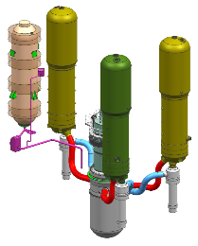
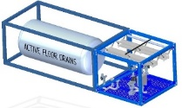
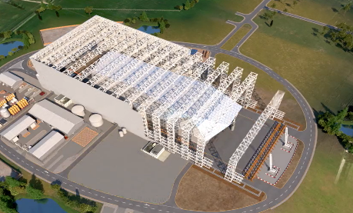
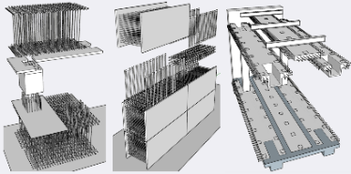
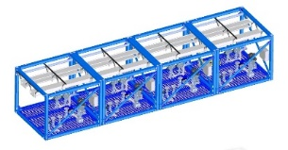
Rolls-Royce SMR is a factory fabricated product
Modularisation of the whole power station, not just the nuclear island
Module Factories
Site Assembly
Primary Plant Modules
Mechanical, Electrical & Plumbing Modules
Civil Modules
Site Assembly Factory
Improves reliability
Improves economies of scale
Creates stable long term jobs
Provides schedule certainty
Reduces build time
Modularisation drives down cost
Notes:
Sophie
Not Sensitive

Slide 13






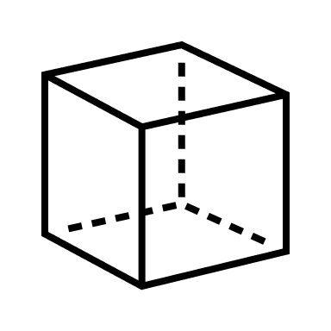


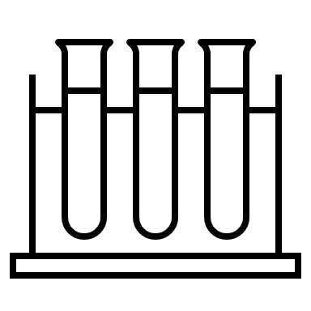


SMR Program - Timeline and Key Milestones
1) Assessment
2) Development and Investment
3) Scaling
Today
Step 2 International Observation of GDA
Multiple orders to generate Fleet demand into Supply Chain
Modules Manufacture
Basis of Design
GDA Start
Commissioning
Continuous for Fleet Demand
Continuous for Fleet Demand
Secure first SMR orders
Finalized program funding
Completion of the Generic Design Assessment (GDA)
Fleet of SMRs operational
(FOAK Mid 2030s)
Continuous for Fleet Demand
Successful completion of Stage 1 of GDA
Verification
and
validation
process
Successful completion of Stage 2 of GDA
Module
Factory Construction Completed
Site Assembly
2016 - 2021
2022 - 2025
2026 onwards

Slide 14

Registration of interest's website
  (Home | Rolls-Royce SMR - Suppliers (rolls-royce-smr.com)
  Initial visit to review capability
  Initial reports and feedback to suppliers
  Added to potential supplier database
Our first Czech Supplier Conference will be held 6th May 2025
Follow us on LinkedIn for latest updates and how to register:
DEVELOPING
A RESILIENT SUPPLY CHAIN

Slide 15
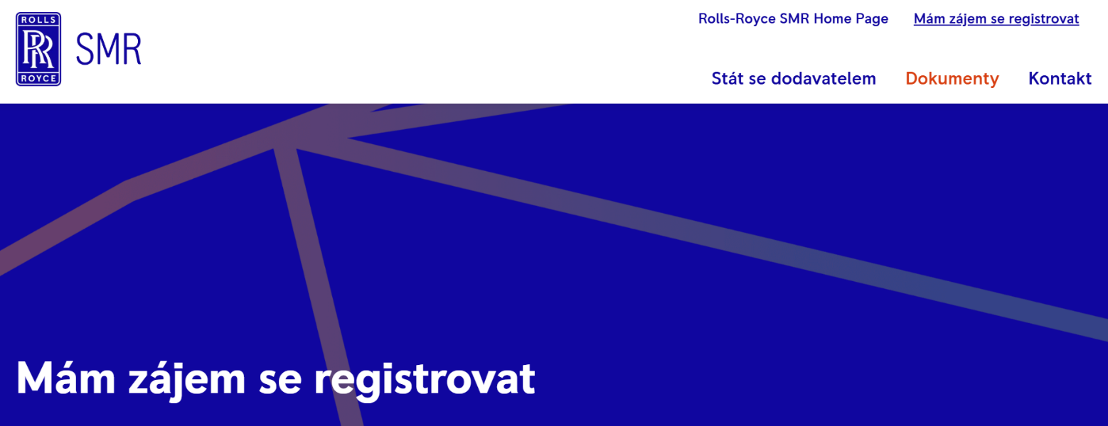

REGISTRATION OF INTERESTS PORTAL
QR Code to Czech Language Supplier Portal:
Website Link: Mám zájem se registrovat | Rolls-Royce SMR - Suppliers - Czech

