Slide 1
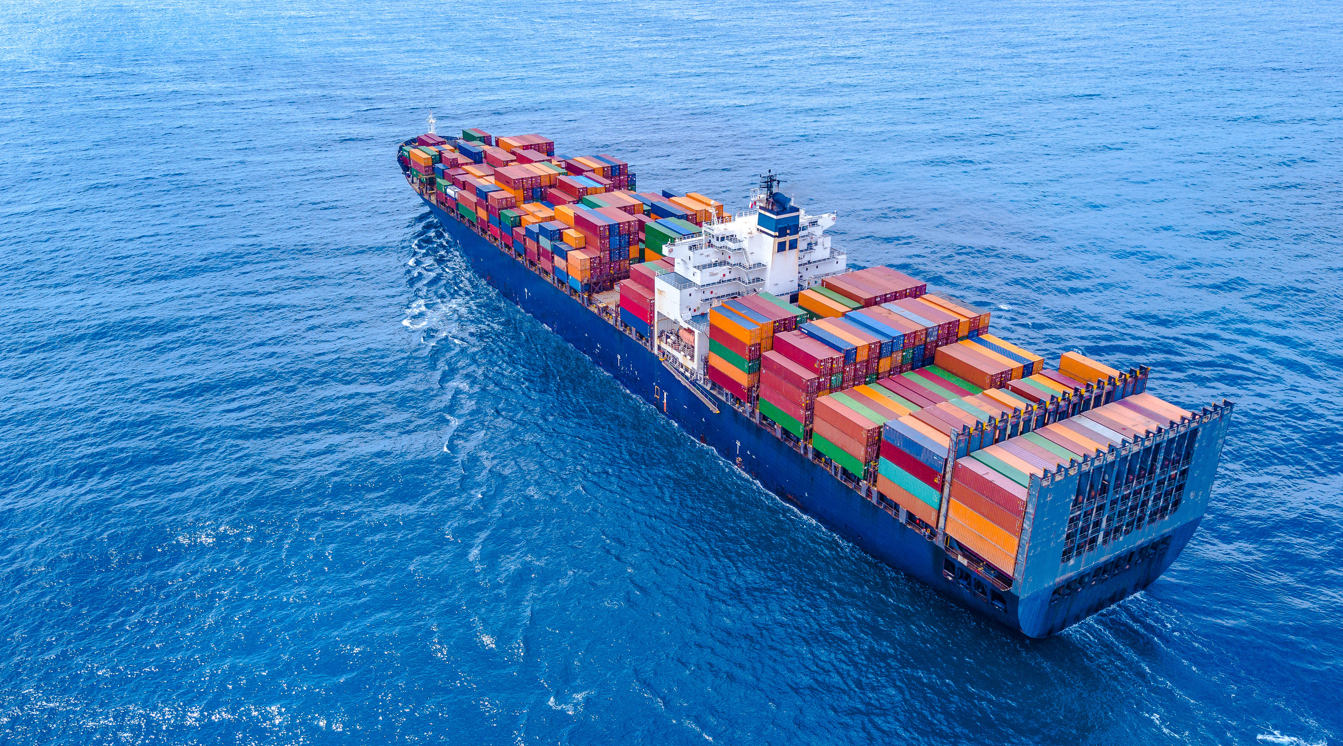

YUSEN LOGISTICS
OCEAN & AIR FREIGHT SITUATION
Tomáš Hašlar, František Klivan
Notes:
Upravit první stránku prezentace – YLK design

Slide 2
YUSEN LOGISTICS BRIEF INTRODUCTION

Slide 3










NIPPON YUSEN KAISHA - PROFILE
Shipping
NIPPON YUSEN KAISHA
OCEAN
1885
Founded
792
VESSELS
BULK/LNG/RoRo/TANKER
President
Hitoshi Nagasawa
$16.4B
Revenue
Logistics
YUSEN LOGISTICS
SUPPLY CHAIN
Global Head Office
Tokyo
Japan
35,711
Employees
Air Cargo
NIPPON CARGO AIRLINES
AIR

Slide 4


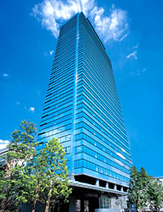


YUSEN LOGISTICS - PROFILE
337,000+
TON (FY2020/21)
AIR FREIGHT
1955
Founded
BY REGION
764,000+
TEU (FY2020/21)
OCEAN FREIGHT
President
Toru Kamiyama
$5.3B
Revenue
2,580,000+
M²
WAREHOUSE SPACE
Global Head Office
Tokyo
Japan
24,500
Employees
595+
Worldwide
LOCATIONS
BY BUSINESS

Slide 5



YUSEN LOGISTICS EUROPE - PROFILE
46,500 +
TON (FY2020/21)
AIR FREIGHT
139
Locations
BY COUNTRY
156,800 +
TEU (FY2020/21)
OCEAN FREIGHT
$1.2B
Revenue
Chief Regional Officer
Hideo Saito
1,146,000 +
M²
WAREHOUSE SPACE
7,500
Employees
13,000,000+
PALLETS (1.6M Shipments)
ROAD FREIGHT
Regional Head Office
Schiphol
The Netherlands
BY BUSINESS

Slide 6




Yusen logistics Czech
9
10
85 200
Krupka – 6 200 sqm
Ústí nad Labem
Krupka
Towns
Sites
sqm warehouse space
Ústí nad Labem – 7 500 sqm
Praha Zlicin
Praha Nové Město
Kolin
Praha Zličín – 1000 sqm
Strancice
Praha Nové Město- ECT
701
2002
2005 – Kolín Branch Operation Launch
2006 – Slovakia Office
2011 – NYK Logistics / Yusen Air Sea Services merger
2017 – European Automotive Control Tower
2021 - SCS division introduction
2022 – 20 years anniversary
Brno
Czech republic
Strančice – 26 000 sqm
Employees
Established
Kolín – 32 500 sqm
Brno, sales office
Gáň – 10 000 sqm
Nitra
Senec
Nitra - LFF centre
Gan
slovakia
Senec – 2 000 sqm

Slide 7
OCEAN FREIGHT SITUATION

Slide 8

SUMMARY
Key facts, circumstances
2009 Global economic crisis
2010 Reduced new ships orders - investment
2011 Price war in OF industry
2014 Ocean carriers’ alliances established – vessel sharing agreement to utilize capacity
2016 Korean carrier Hanjin filed for bankruptcy – reduced global capacity
2020 IMO 2020 – Low sulfur fuel
Covid in China
Christmas peak
Lack of containers
Lockdown in CN
Recovery in China
Lockdowns in the rest of world
Autumn China holiday
CN export increase
Reduced capacity

Slide 9

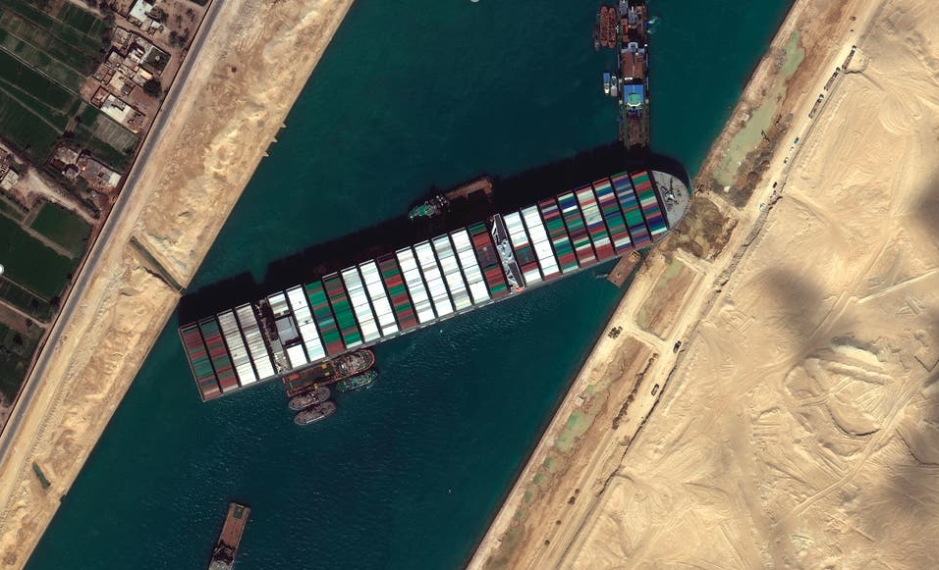

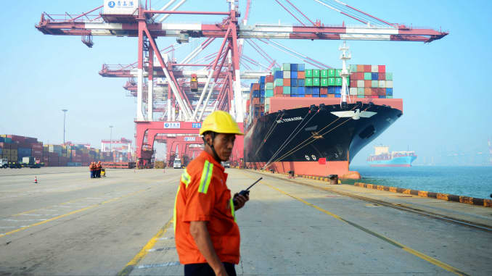
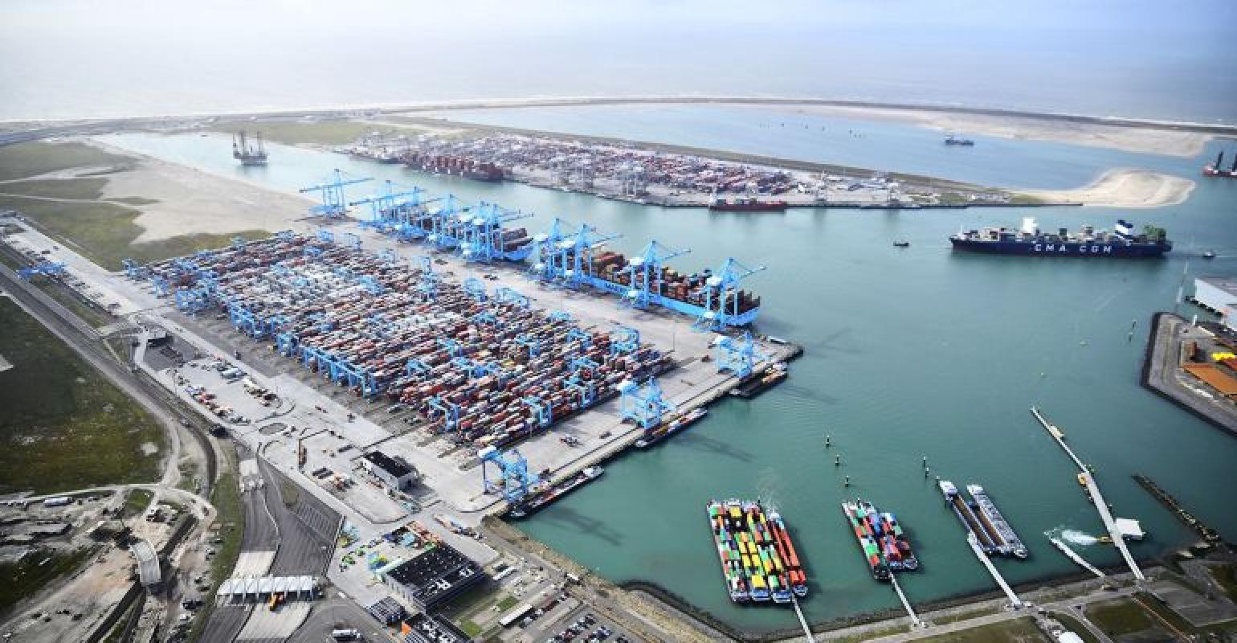

OTHER EVENTS IMPACTING GLOBAL LOGISTICS
Ever Given seized in Egypt
after blocking Suez Canal
Yantian Port Operations face heavy delays as COVID-19 cases continue to rise
Aggressive fight over containers is causing shipping costs to rocket by 300%
Crunch at European ports after Suez unblocking
Local incidents causing the operation slowdown
Source: SeaTrade Maritine News, BBC, Lloyds List, CNBC

Slide 10
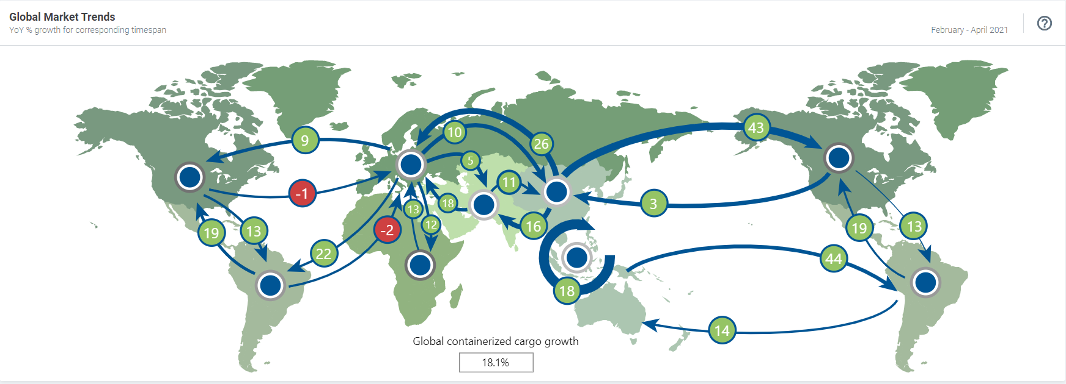
GLOBAL OVERVIEW OF OCEAN MARKET
Strong containerized cargo growth in the first months of 2021
Source: Seabury

Slide 11
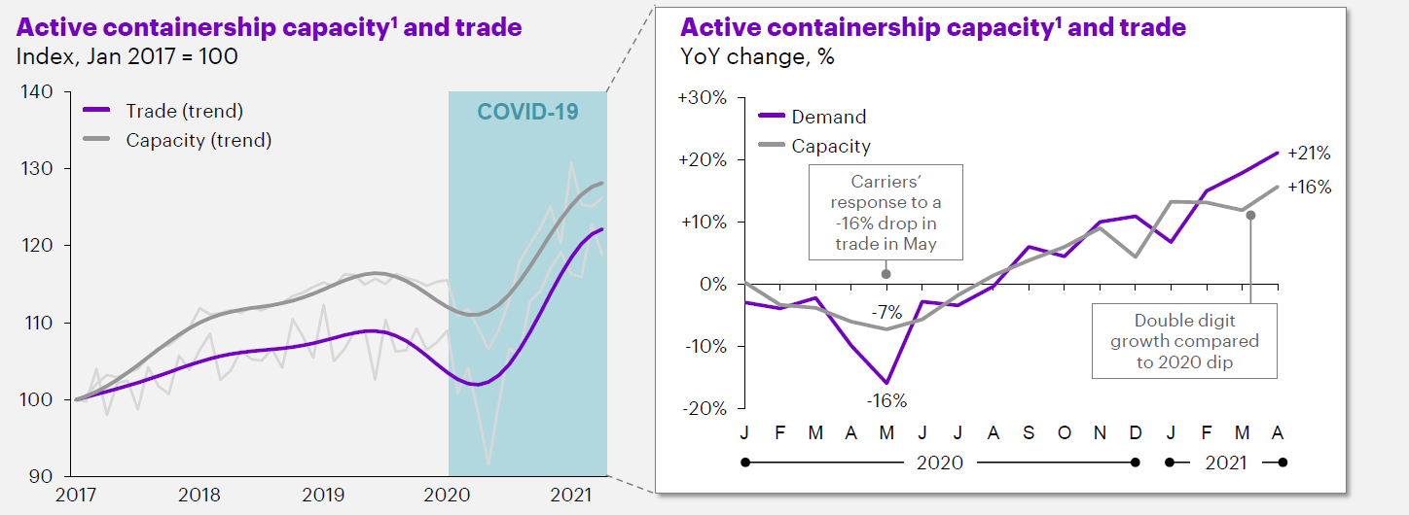
GLOBAL OCEAN FREIGHT: SUPPLY V. DEMAND
Despite double digit capacity growth in 2021, demand grew faster
Active containership capacity and trade
Active containership capacity and trade
Demand growth is constrained by capacity growth as of today
Source: Accenture

Slide 12
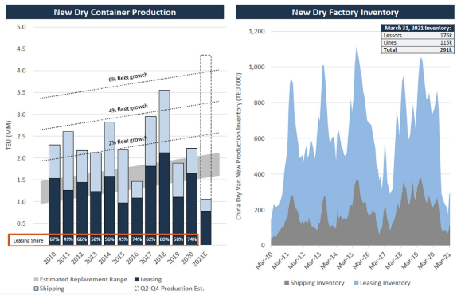
GLOBAL OCEAN FREIGHT: EQUIPMENT AVAILABILITY
Global container shortage likely to last until 2022
Lack of containers on market /lease vs shipping/
Slow down of container rotation port – door – port ( especially US )
Production increased 6-8% – 2021 /890 000teu
80% of container production located in China
Boxes aren’t being built fast enough to ease the capacity crunch
Source: Freight waves, Supply Chain Dive
Copyright © 2021 Yusen Logistics. All rights reserved

Slide 13
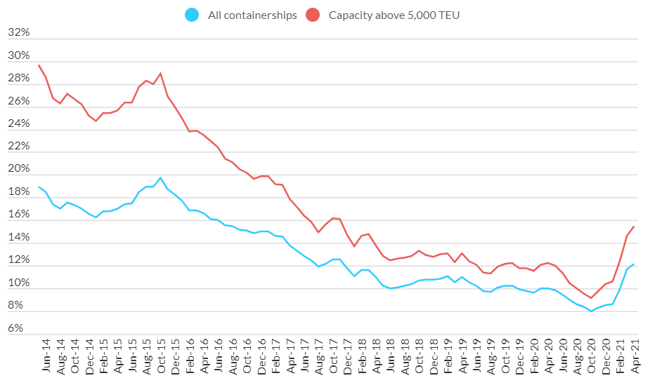
GLOBAL CONTAINER SHORTAGE
Containership shortage and Orderbook
Global freight rates will remain high in the short term but will moderate in the longer term once shipping supply-chain disruptions are cleared and more new ships are deployed.
The long-term unsustainability of current rate levels is further supported by a rapidly growing containership orderbook, especially for larger vessels, i.e., 5,000 TEU capacity and above. Additional global shipping capacity will restore the market’s supply and demand balance. However, there is a lag of two to three years between the placement of vessel orders and delivery.
Global Containership Orderbook (as % of current fleet)
All containerships
Apr-21: 12.13%
Capacity above 5,000TEU
Apr-21: 15.47%
Source: JOC, Fitch Ratings​
Copyright © 2021 Yusen Logistics. All rights reserved
Source: Fitch Ratings, Bloomberg

Slide 14
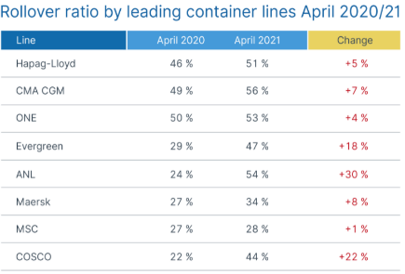
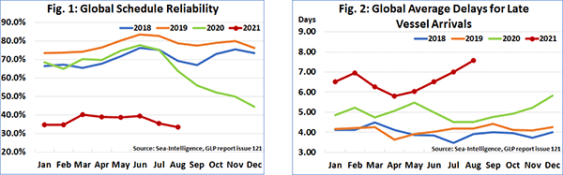
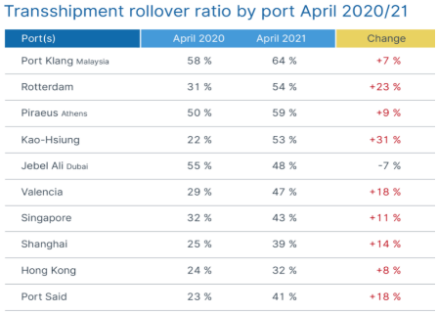
SERVICE QUALITY
Another 'new normal' as container rollover rates continue to increase
Source: Ocean Insights, Loadstar
Copyright © 2021 Yusen Logistics. All rights reserved

Slide 15
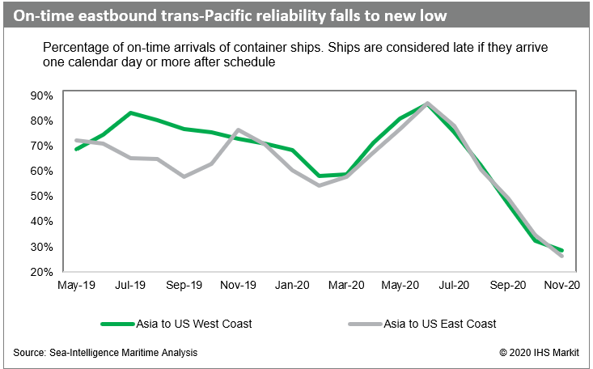
DETERIORATING ON-TIME RELIABILITY
Global scheduling reliability dropped to 50.1% in November which means that for the 4 consecutive months, global schedule reliability has been the lowest across all months since 2011.
The major causes are related to weather related issues and port congestions at origin and destination. On the Trans-Pacific trade, container ships had to sit at anchor for 6 days or longer awaiting berthing space.
We highly recommend our customers to plan for delays during Chinese New Year. Please contact us to provide more detailed suggestions based on your cargo flow.
KEY HIGHLIGHTS
All carrier alliances continue to face on-time reliability issues
All alliances (THE Alliance, Ocean Alliance and 2M are showing similar levels of on-time reliability deterioration

Slide 16
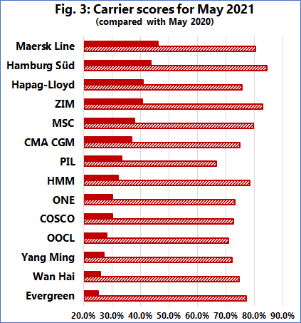
CARRIER SCHEDULE RELIABILITY
Carrier scores - schedule reliability
Carrier scores 2021 vs 2020
The latest report by Sea-Intelligence covers schedule reliability across 34 different trades lanes and 60+ carriers.
The level of delays in 2021 have been the highest across each month when compared to the previous years. Maersk Line was the most reliable top-14 carrier in May 2021, with schedule reliability of 46.2%. Three more carriers had schedule reliability higher than 40%, with six carriers between 30%-40%, and four under 30%.
Source: Sea-Intelligence
Source: SeaNews, Sea-Intellgience
Copyright © 2021 Yusen Logistics. All rights reserved

Slide 17
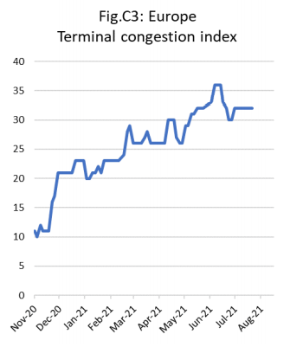
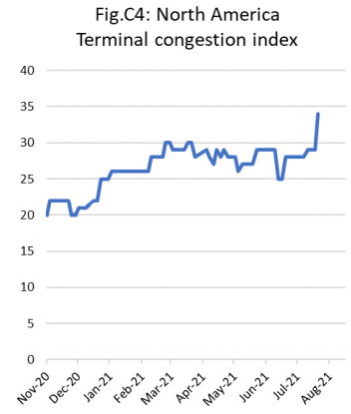
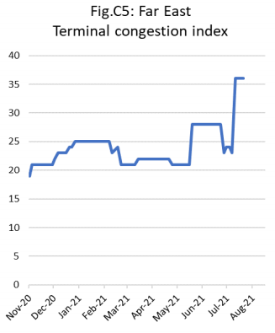
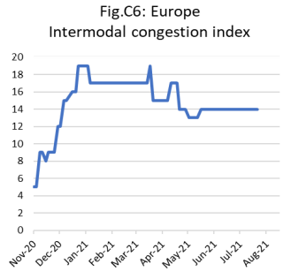
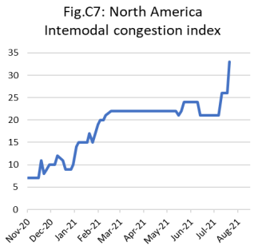
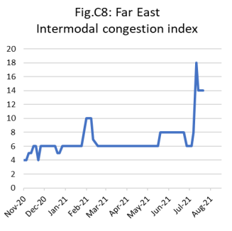
WORLDWIDE LOGISTICS CHALLENGES…
Congestions are everywhere…
As per the index provided by Sea-Intelligence, all major terminals not only in Europe but globally are struggling with the sever congestions which seem to remain the same or worsening. Vessel delays, long equipment turn-over time (which is also worsening in China again), slow operation due to Covid19 measures, shortage of haulage drivers etc etc… Nothing is helping us to overcome the logistics challenges positively at the moment.
Intermodal congestion is also only another spice of it. Criticalness of this challenge in UK as well as North America is extreme.
Sources: Sea-Intelligence

Slide 18
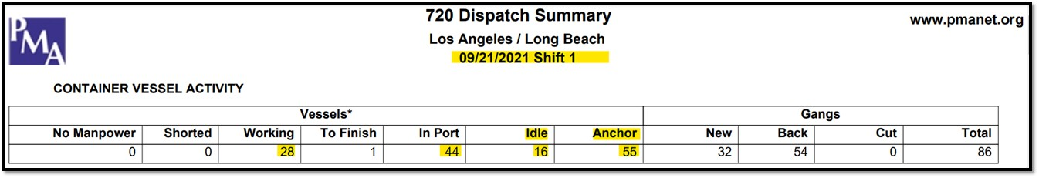
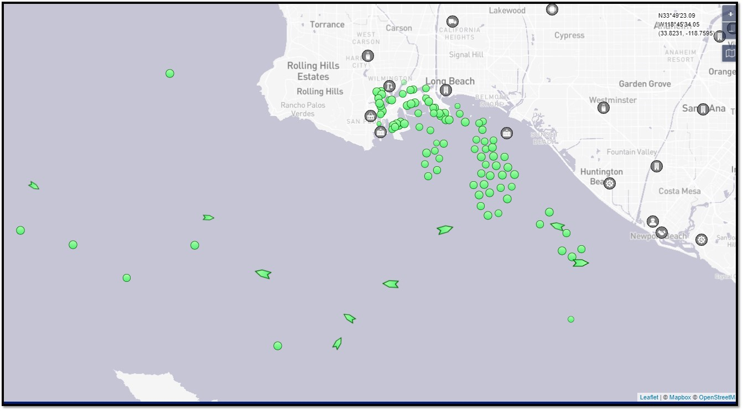
US WEST COAST PORT & DRAYAGE STATUS UPDATE
Los Angeles & Long Beach continue to face massive Port Congestions and Drayage Issues
Did you know?
71 Container vessels currently sit idle or anchored outside of LA/LB ports awaiting to dock and to be unloaded (record high)
44 vessels inside the port complex with only 27 being worked today
LA/LB incoming volumes expected to increase in coming weeks
2505 PoP chassis are out of service and chassis street dwell time is approximately 9.9 days
Longer dwell time is due to no appointment for empties, no termination point, lack of drivers, warehouse labor shortage and no space at the ports
Average price of fuel in California is USD4.329
As a result, customers are facing longer transit time as well as port/drayage related additional surcharges on Trans-Atlantic Westbound trade
Note: While loaded export out of USWC decreased YoY, loaded import into USWC increased by 29.3% YoY. Carriers are choosing to ship empties back out to Far East thus resulting in 52% growth over last year
Source: LA Customs, FF Association, Foreign Trade Association

Slide 19
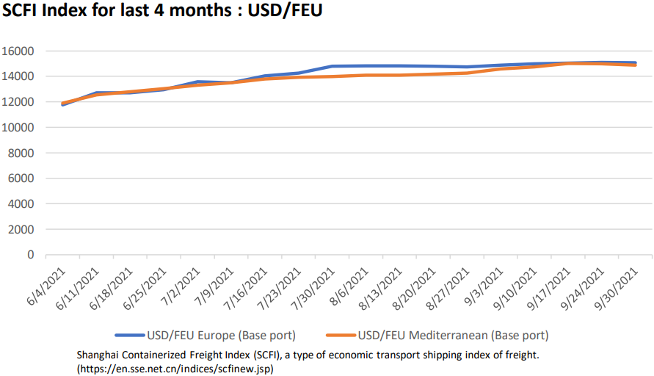
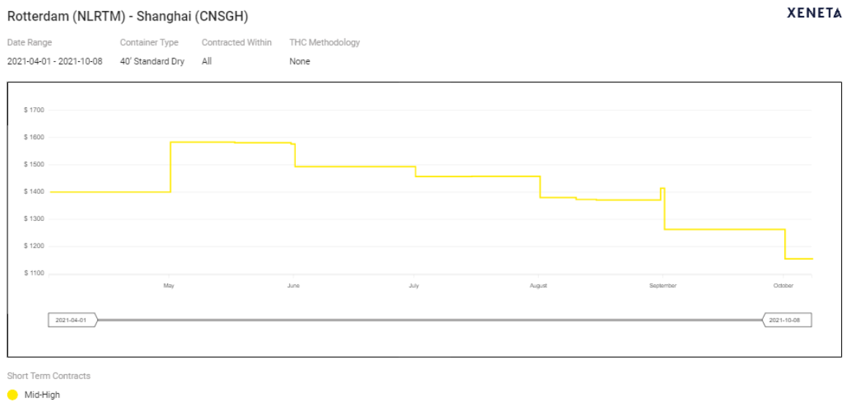
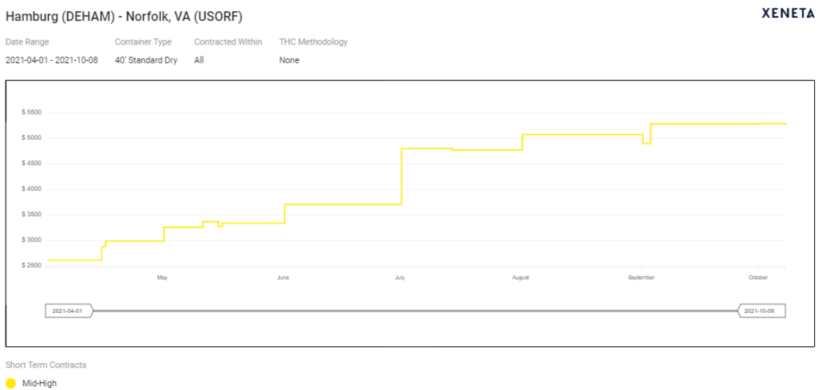
OCEAN FREIGHT MARKET
Freight index
AEWB Trade
AEEB Trade
Sources: Shanghai Freight Index
TAWB Trade
The rate level of AEWB and TAWB remain high
The rate levels for Asia Europe West Bound and Trans Atlantic West Bound remain high and is likely expected to be so for the rest of this year. Meanwhile there is some tendency of rate reduction in Asia Europe East Bound.

Slide 20

PRICE TREND FOR 2022
As of early November, there are still very limited number of carriers that are ready to discuss the long-term deals for 2022.
Some carriers in Europe may be ready to offer the rates and conditions for 2022 but majority is for the renewal of existing deals, not for the new business.
Those offers from carriers for next year, if any, seem to insist the multi-year deals (i.e. two to three years, not one year).
Other carriers especially Asian carriers are very cautious with price level as well as the length of validity.
It is still too early and difficult to expect the next year’s rate level and the tendency of normal contract duration.
With all factors around the market (Supply vs Demand, vessel delay, equipment issue, heavy congestions etc etc), the likeliness of price level in 2022 remaining in between 75% to 100% of what we are experiencing today seems to be high.

Slide 21

YUSEN LOGISTICS RECOMMENDATION
First, ask your incumbent LSP what they can do for you
Working with reliable Main Partners and Back up Partners are Key to Success
Ask about latest on-time reliability and how many days you need to buffer for delays
Ask about different pricing mechanisms according to the market and your needs
Diversity your Transportation Mode (LCL, Sea+Rail, Direct Truck, etc)
Postpone your tender process if feasible
Stay connected about what is happening in the market
Test your Supply Chain

Slide 22
SUMMARY
Key facts leading to current situation
Exhausted carrier – bancruptcy
Reduced economic aktivity due to Covid
Demad increase – uneven recovery
Increased exports from China
Empty container transportation reduced
Christmas peak in USA
Lack of drivers, chassis and manpower

Slide 23
QA

Slide 24
Thank you

Slide 25
OTHER ALTERNATIVES?

Slide 26
AIR FREIGHT SITUATION

Slide 27
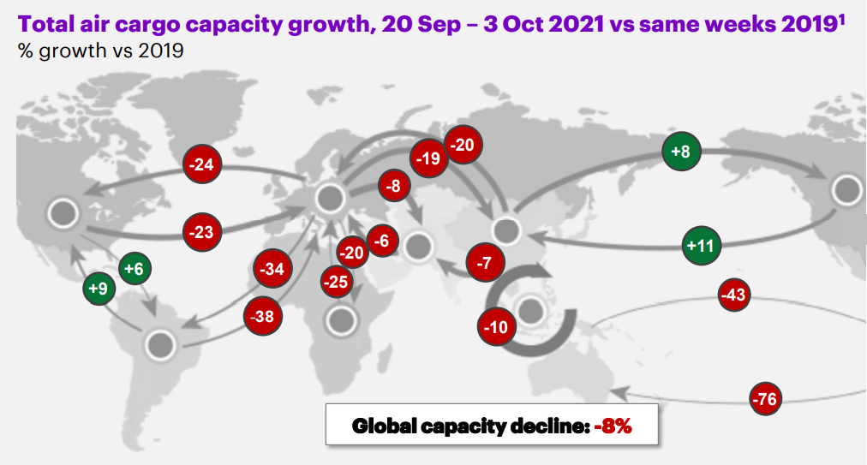
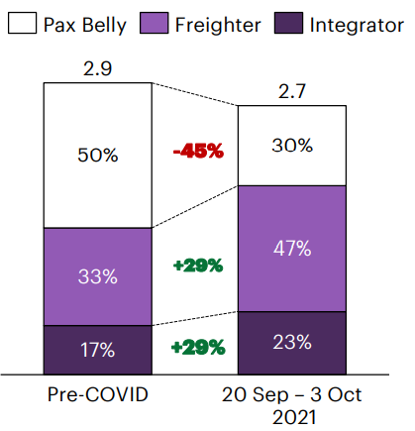
AIR FREIGHT
Worldwide capacity situation

Slide 28
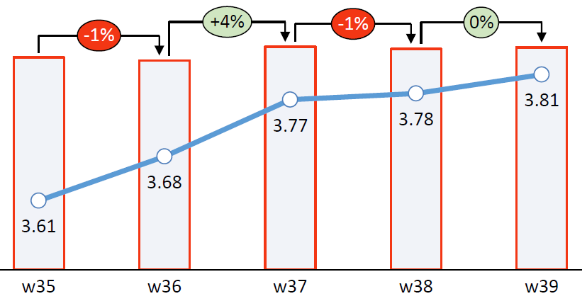

AIR FREIGHT
Air cargo rates skyrocket again as forwarders scramble for capacity
An imbalance between supply and demand is emerging, with airlines continuing to convert passenger aircraft into temporary cargo planes, but still not enough.
According to a forwarder, both regular airfreight shipments and charter costs have “exploded” and, in some cases, “increased tenfold within a week. The demand for charter flights is fuelled by increase in ocean freight rates on the major tradelanes, driver shortages in Europe and the continued lack of belly capacity.
Many airlines are now operating at nearly 100% capacity, which means airports are heavily congested and global delays are inevitable. This situation is currently evident at import airports such as Atlanta, Frankfurt and New York.
With a view to the end of the peak season, the market is expecting this situation to worsen further.
Source: WorldACD, Loadstar​
Copyright © 2021 Yusen Logistics. All rights reserved

Slide 29
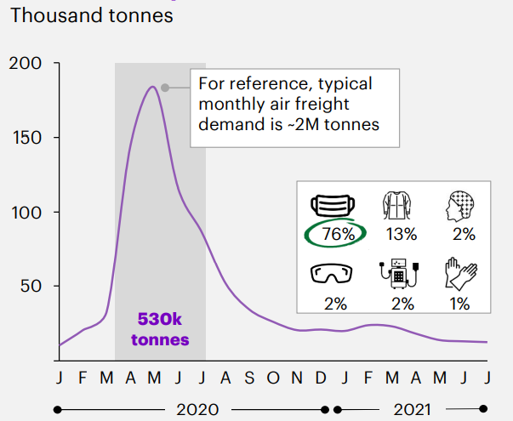
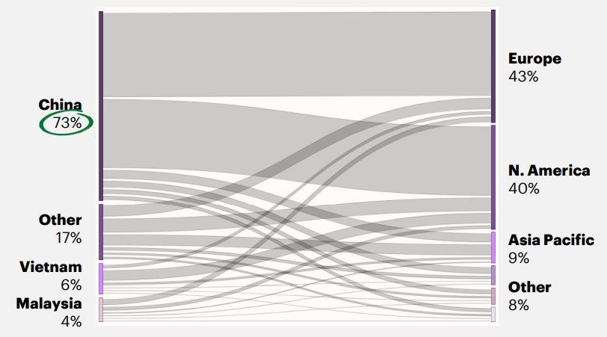
AIR FREIGHT
Commodity impact on space and price

Slide 30
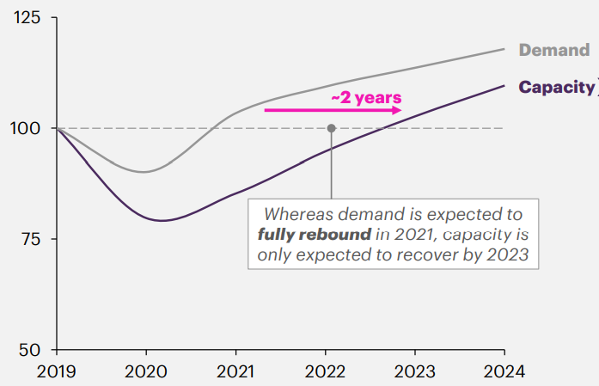
AIR FREIGHT
Cargo demand and capacity situation

Slide 31
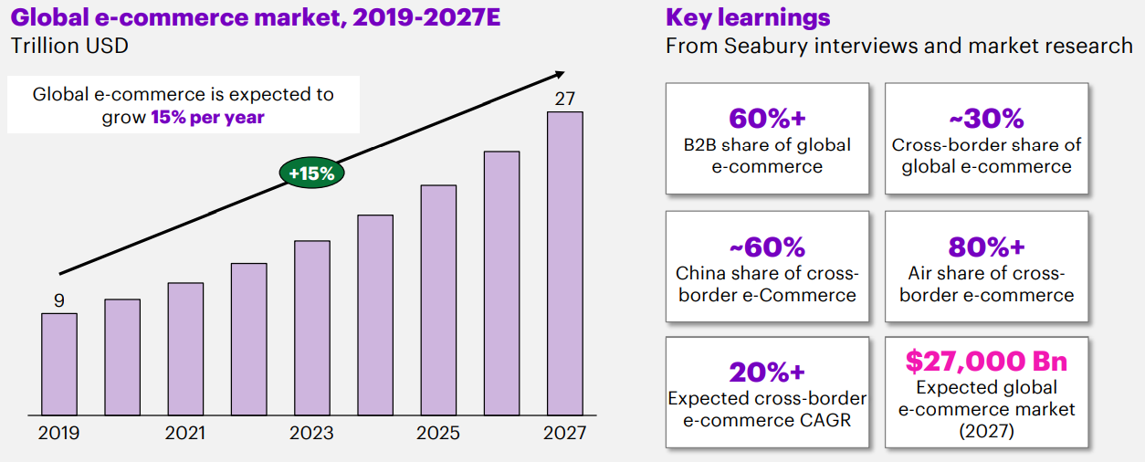
AIR FREIGHT
E-Commerce fast growing

Slide 32
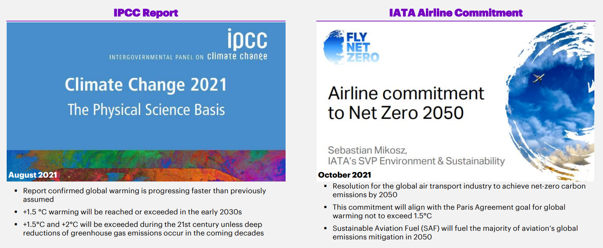
AIR FREIGHT
New fuel in Air Freight

Slide 33
RAIL SOLUTION

Slide 34
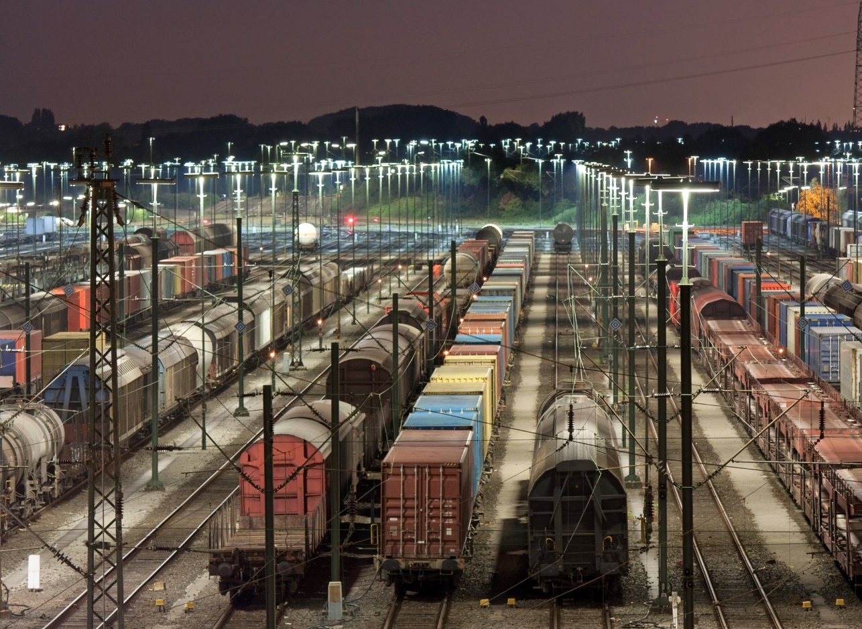
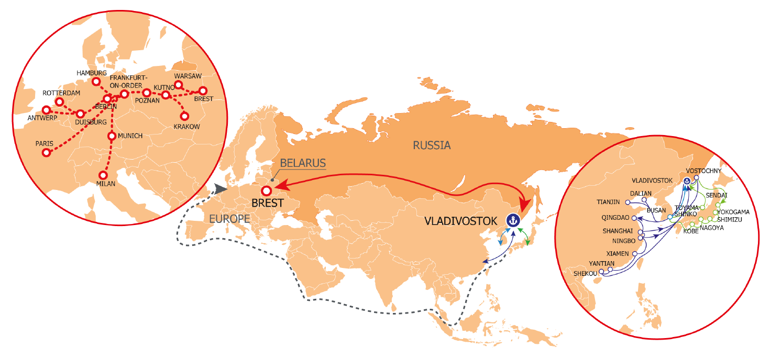
Rail Product and new Sea-Rail solutions.
Any solution to avoid the challenges in ocean shipping…?
Recently due to current market situation, Yusen has been involved in developing new successful solutions as alternative to current Ocean Freight market situation.
Far East Russian ports of Vladivostok and Nakhodka are added to our sea-rail service from Asia into Europe to coop and provide stability with strong points in terms of costing and avoiding current
congestions at the rail terminals in Kazakhstan and Belarus/Poland.
There are constant new block-train formed to cope with the demands. The rail freight charge level remain similar to the ocean freight charge today but will provide some more capacity than ocean shipping, with the constant developments and steady growth.

